Slide 1
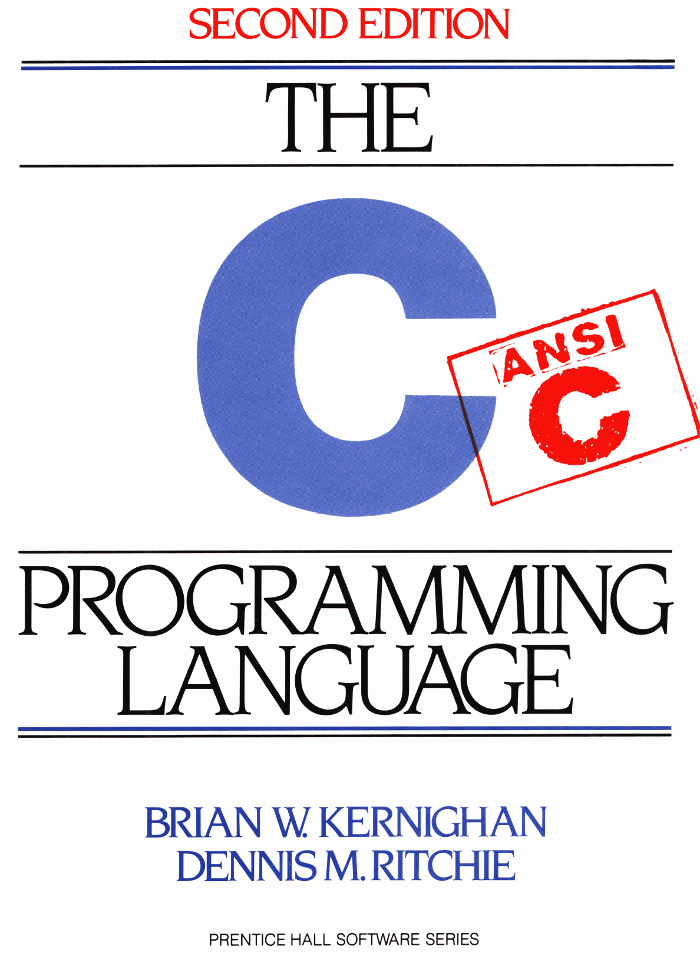
Chapter 8: Unix System Interface Kianoosh G. Boroojeni

Slide 2
Chapter 8: The UNIX System Interface _ Objectives
Learning how to use some of the most important UNIX system calls from C programs:
Learning I/O system calls
Learning system calls related to File System
Learning system calls for storage allocation

Slide 3
File Descriptors in UNIX
Small non-negative integer for every file in UNIX
Is used instead of the file name to identify it.
When opening a file, open function returns pointer to FILE which is a structure containing FD
Every Peripheral device (even keyboard and screen) is a file in UNIX file system.
Since input and output invoking keyboard and screen is so common,
File Descriptor 0 is reserved for standard input;
File Descriptor 1 is reserved for standard output;
File Descriptor 2 is reserved for standard error;
Possible to redirect standard I/O to and from files using < and >: programName <infile >outfile

Slide 4
Low Level I/O _ Read & Write
int n_read = read( int fd, char *buf, int n);
Transfers up to n bytes from fd to buf
int n_written = write( int fd, char *buf, int n);
transfers up to n bytes from buf to fd
Each call returns the number of bytes transferred or -1 if an error happens.

Slide 5
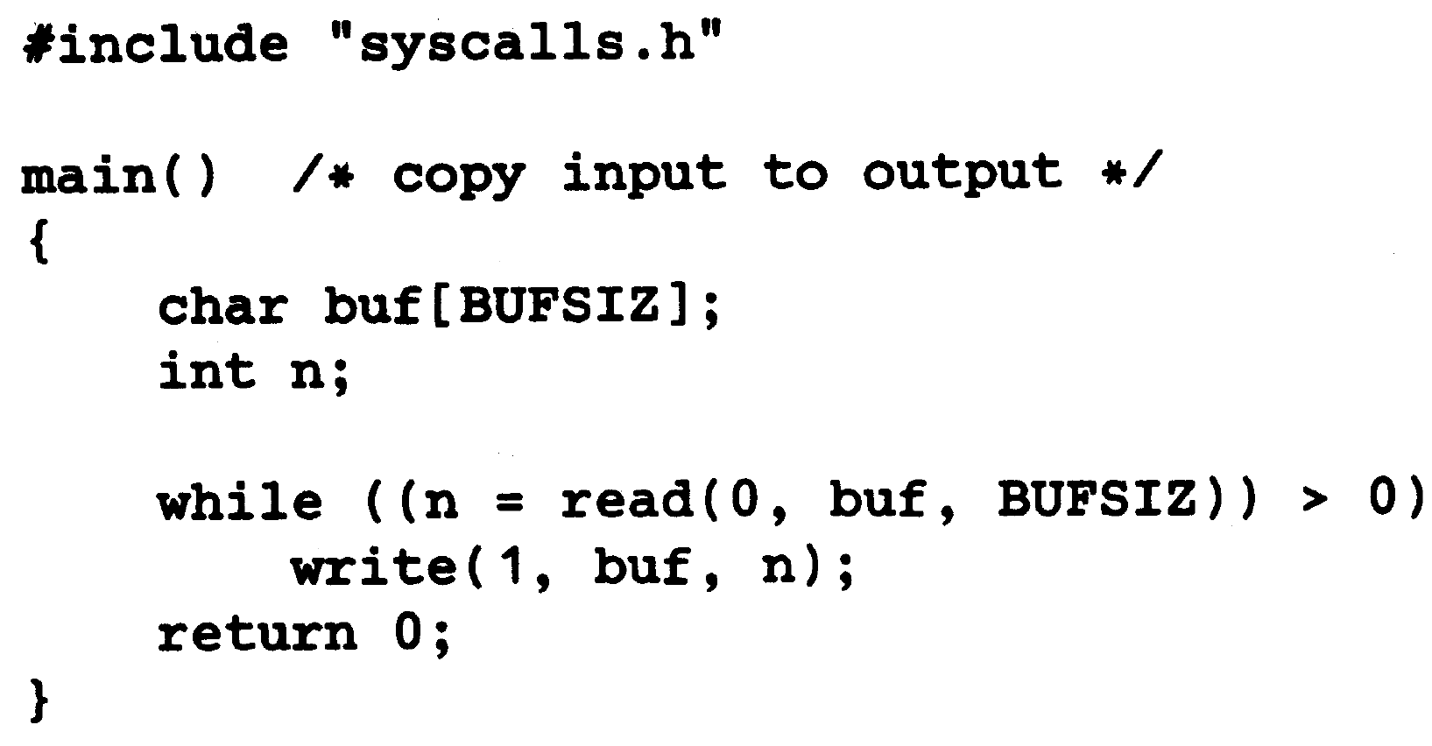
Copying Standard Input to Standard Output

Slide 6
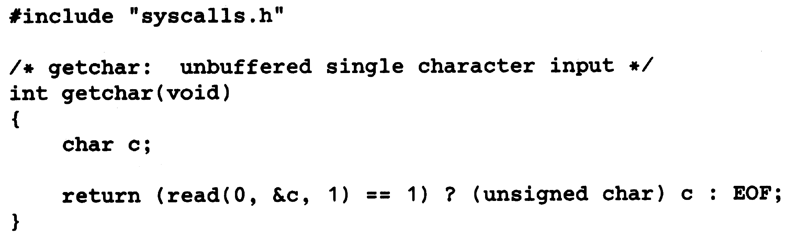
Implementing getchar Function

Slide 7
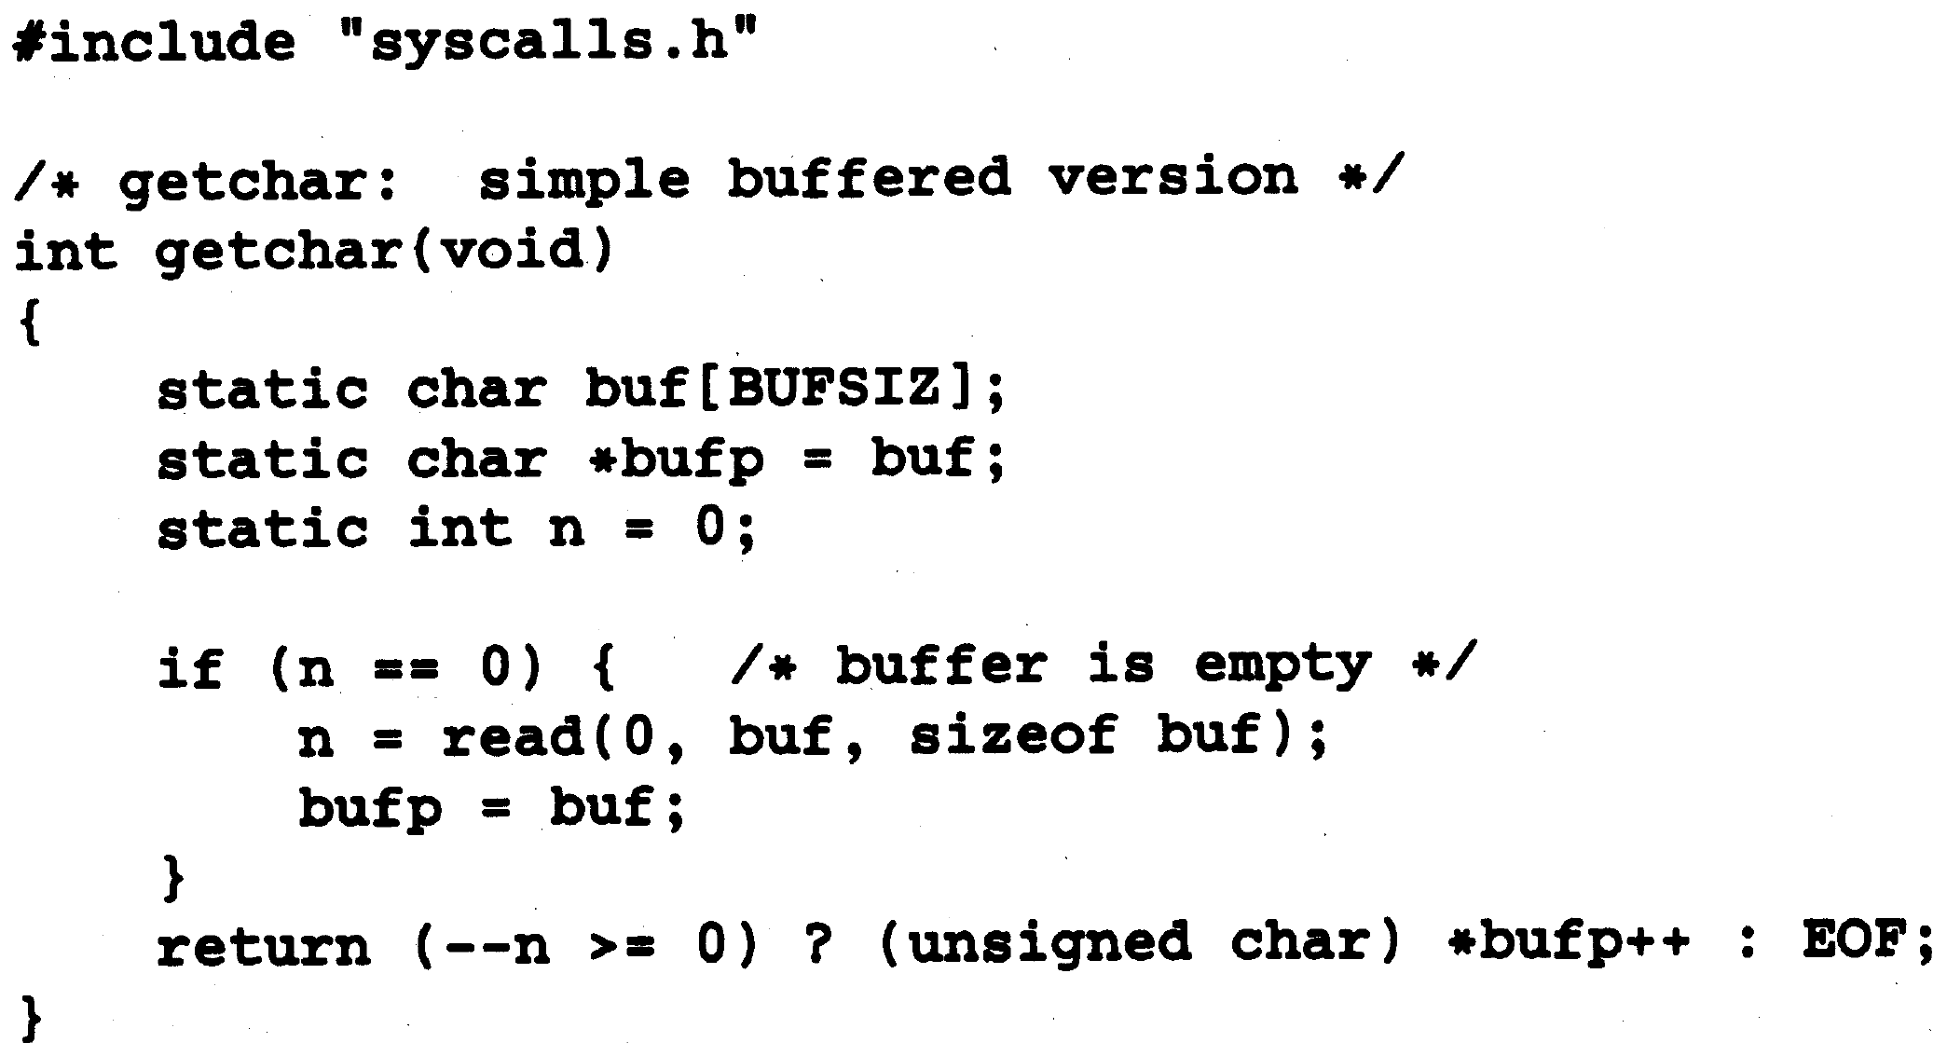
Implementing getchar Function (Buffered Version)

Slide 8
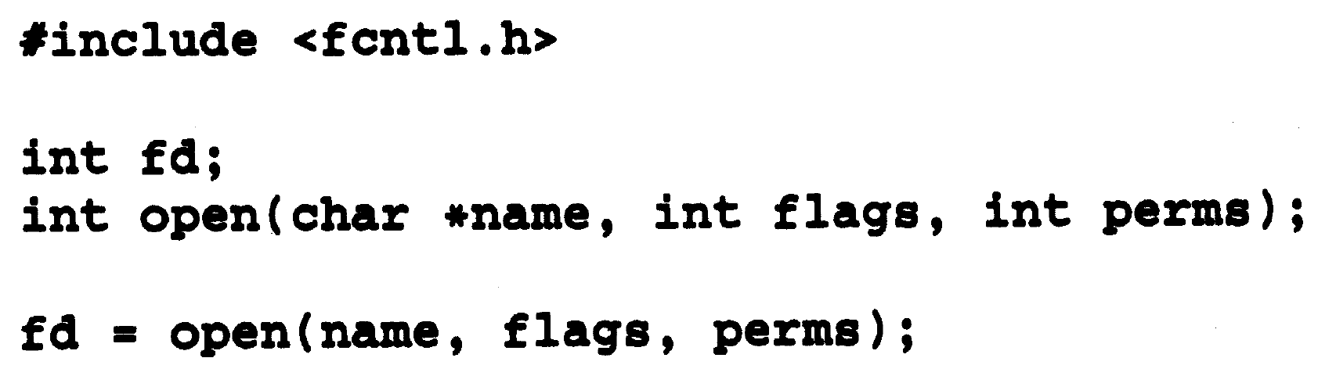
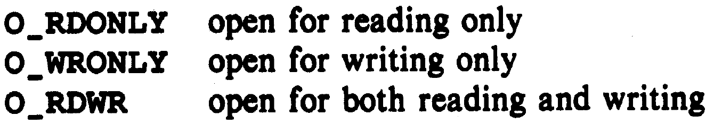
Handling I/O for Files: Open Function
Flags:

Slide 9
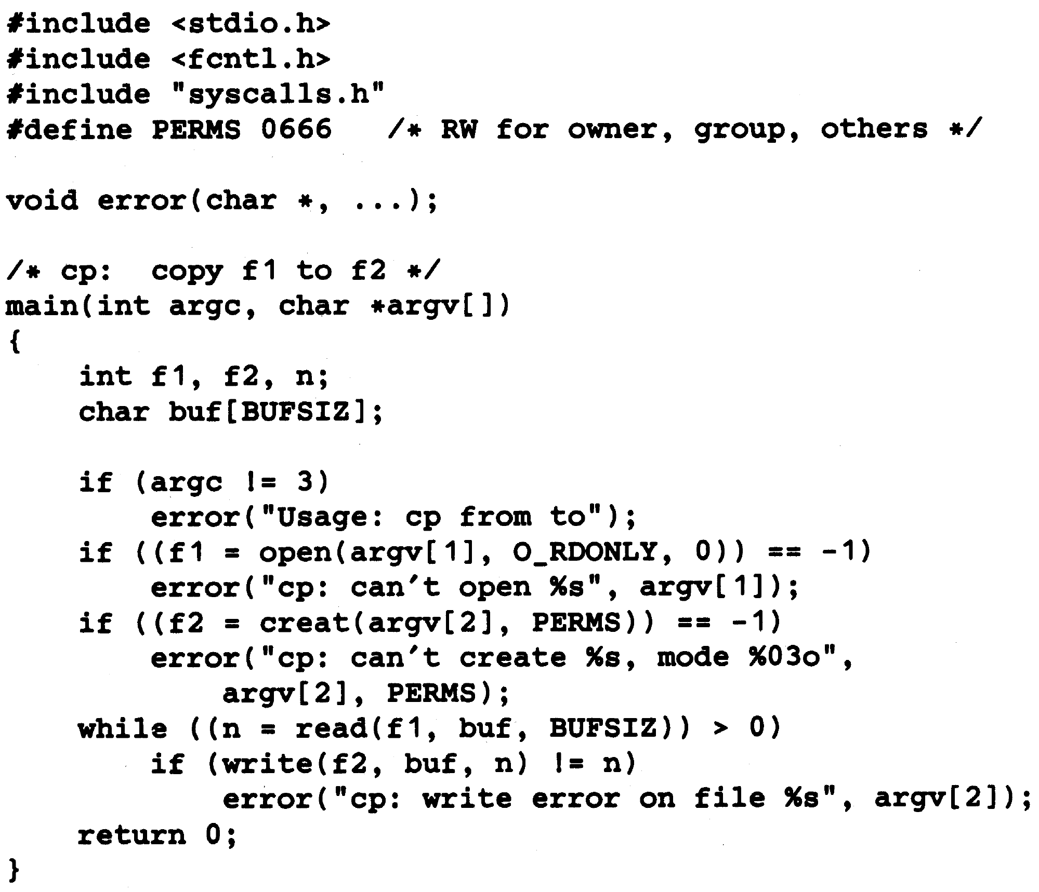
Copy a File to Another

Slide 10
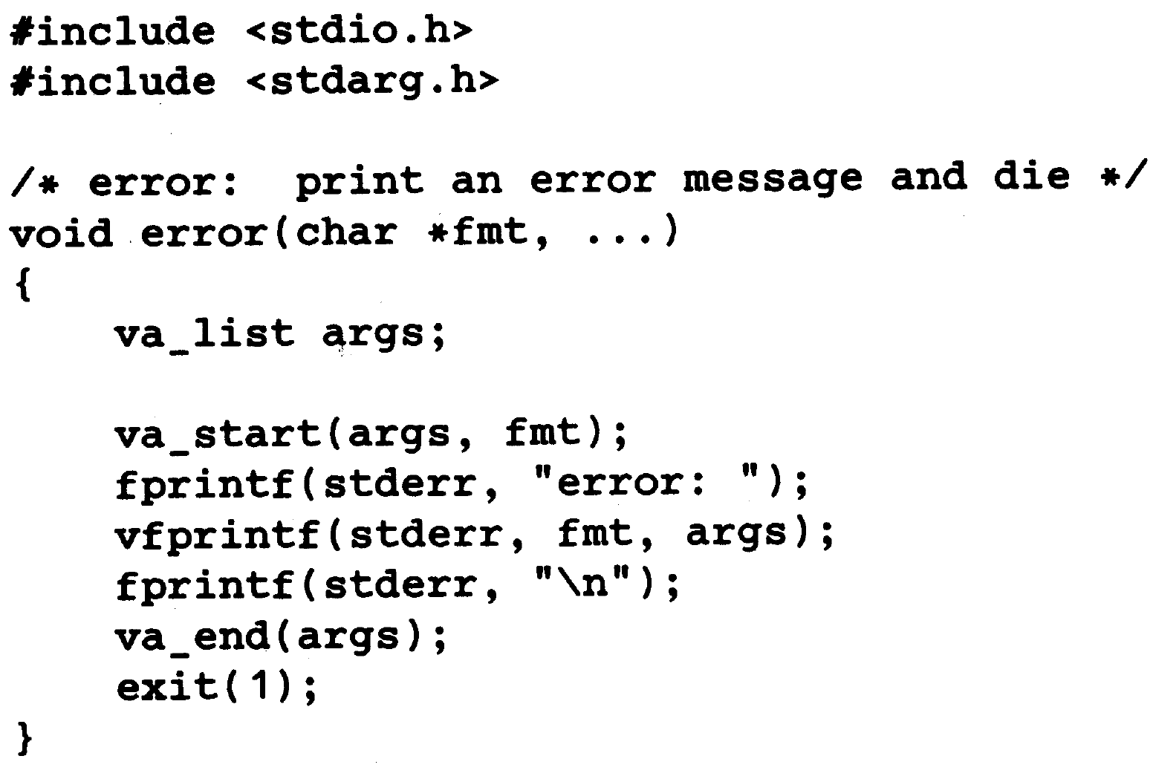
Printing Error Message

Slide 11
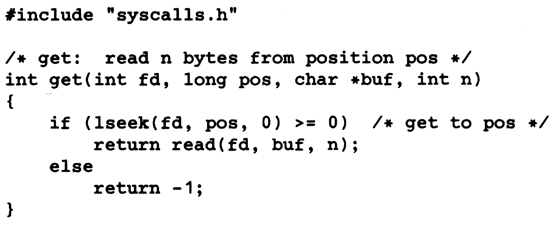
Random Access (LSEEK)
long lseek (int fd, long offset, int origin)
origin = 0, 1, or 2
means that offset must be measured from the beginning, current position or end of the file.
Move around in a file without reading or writing

Slide 12
Random Access (LSEEK)
To append to a file, before writing, seek to the end of file using:
lseek (fd, 0L, 2)
To rewind (get back to the beginning):
lseek (fd, 0L, 0)
Write a program that copy the characters of file 1 (FD = fd1) to file 2 (FD = fd2) in reverse order.

Slide 13
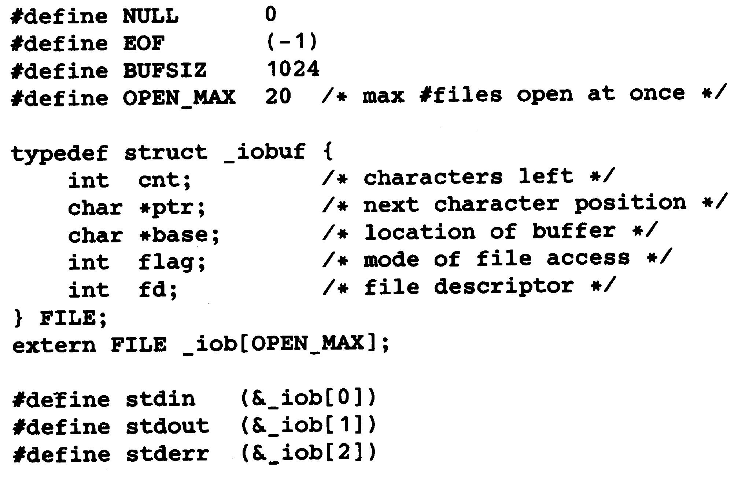
Implementation of Fopen and Getc

Slide 14
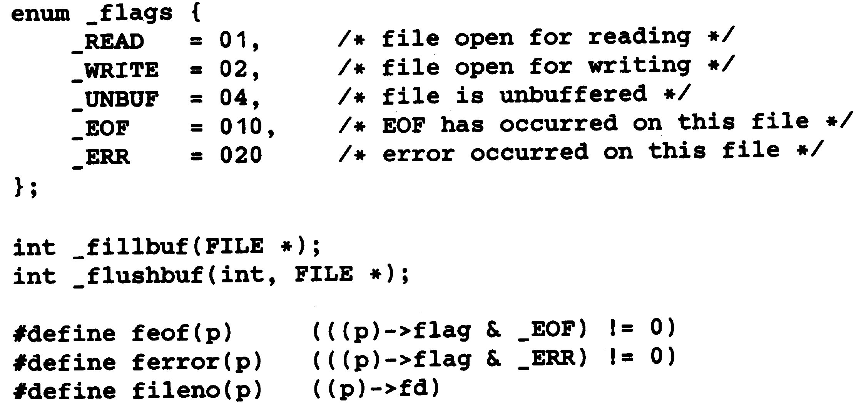
Implementation of Fopen and Getc

Slide 15
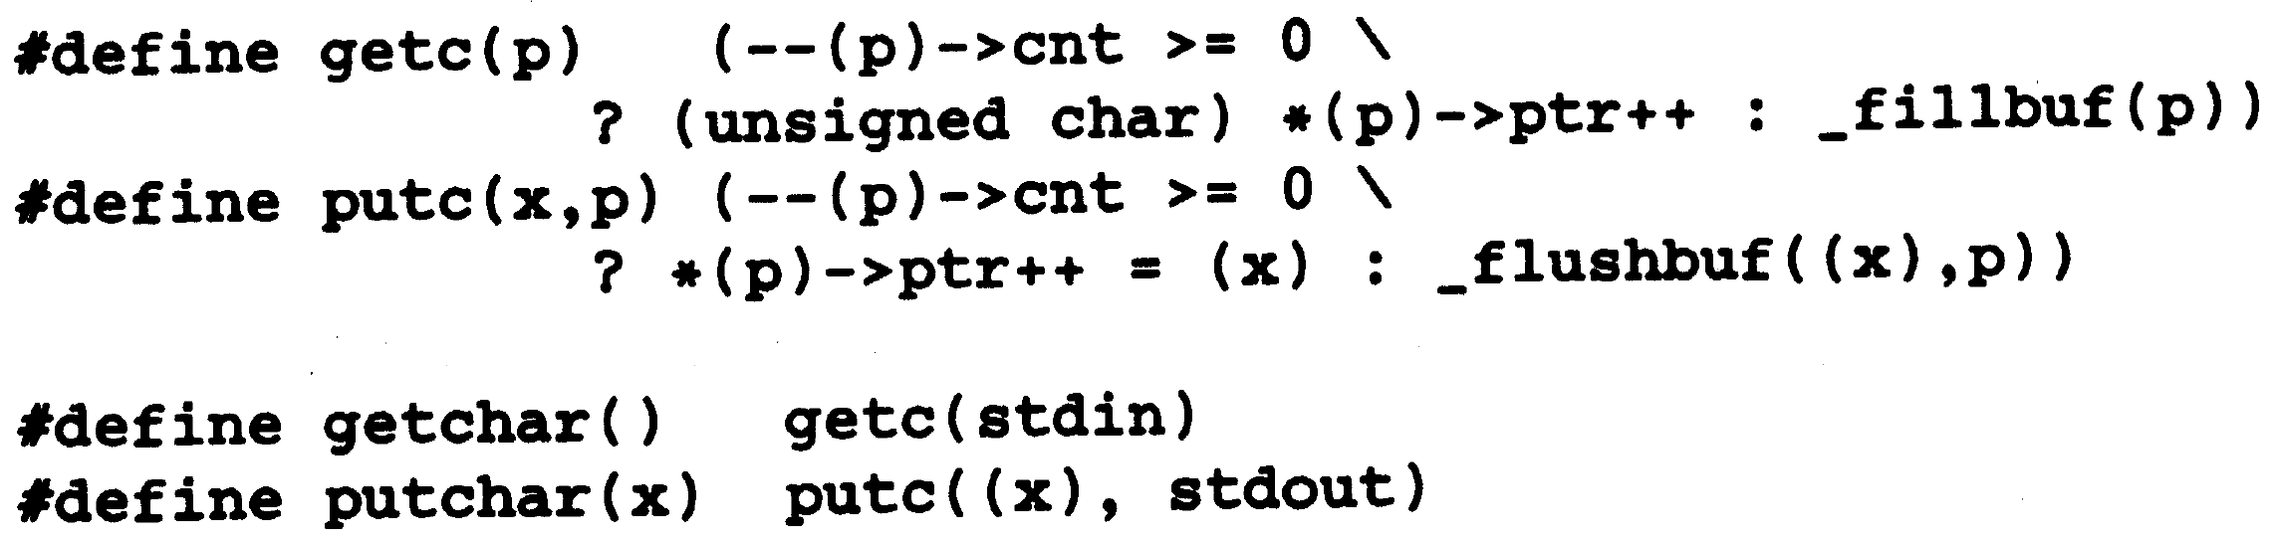
Implementation of Fopen and Getc

Slide 16
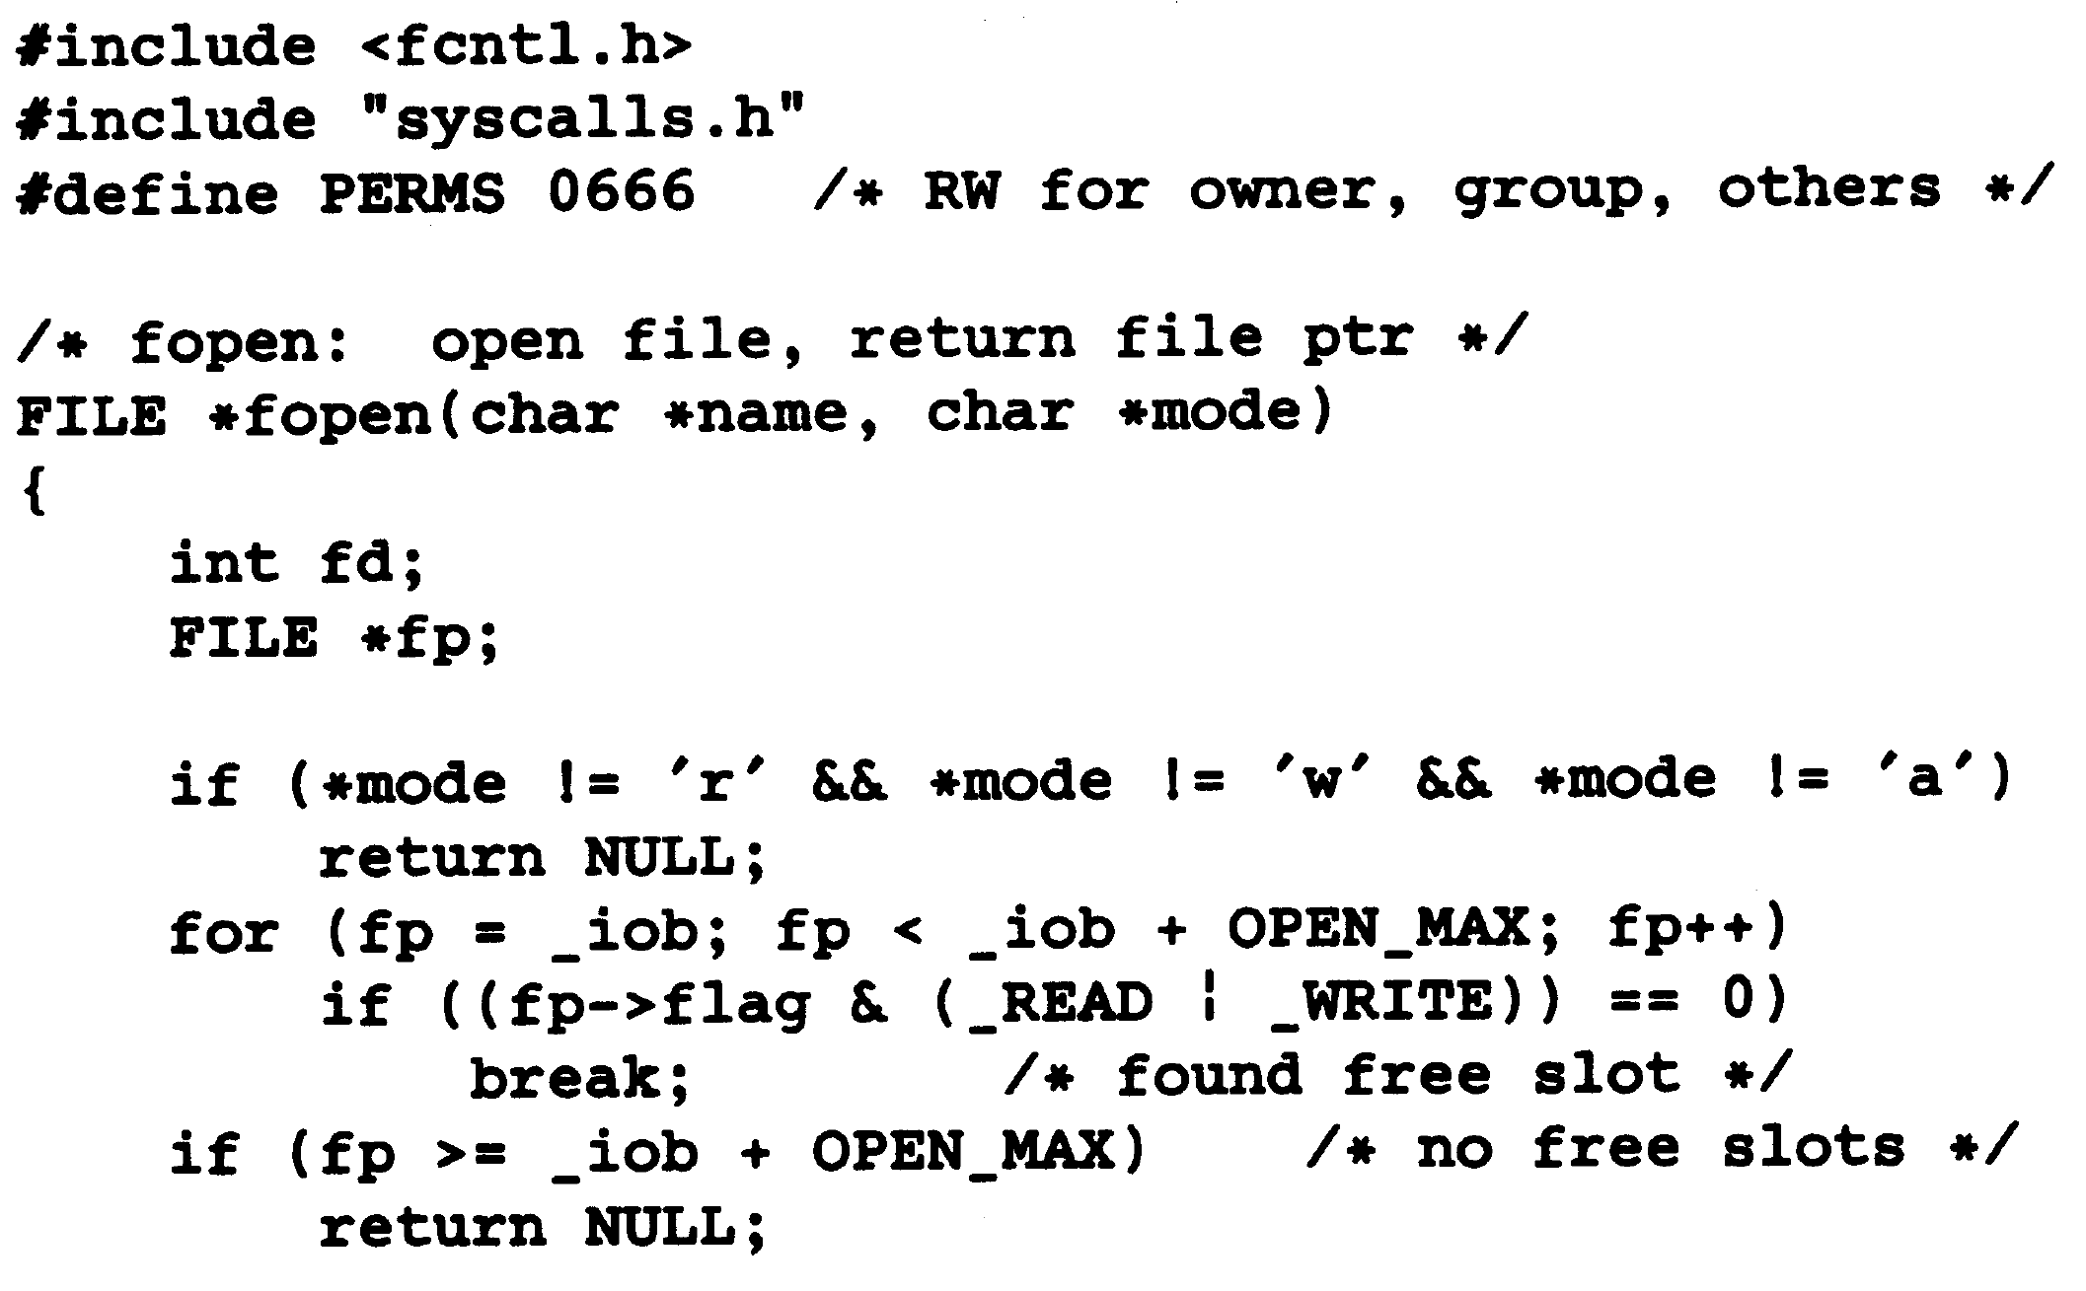
Implementation of Fopen and Getc

Slide 17
Implementation of Fopen and Getc

Slide 18
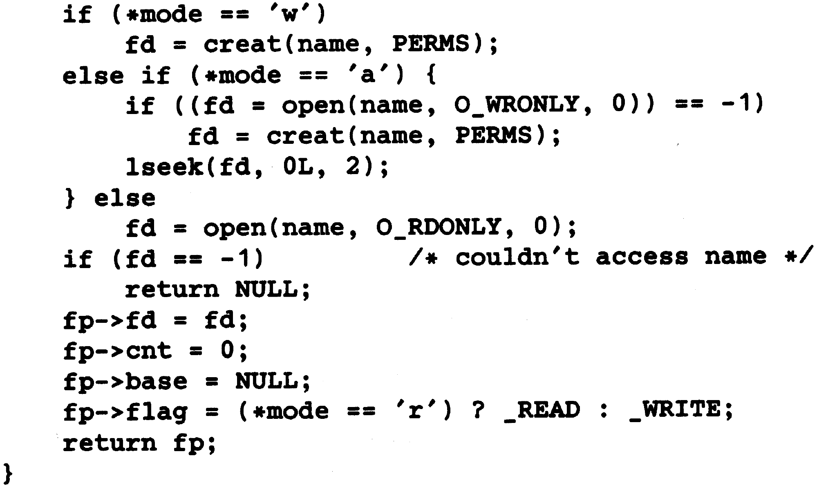
Implementation of Fopen and Getc

Slide 19
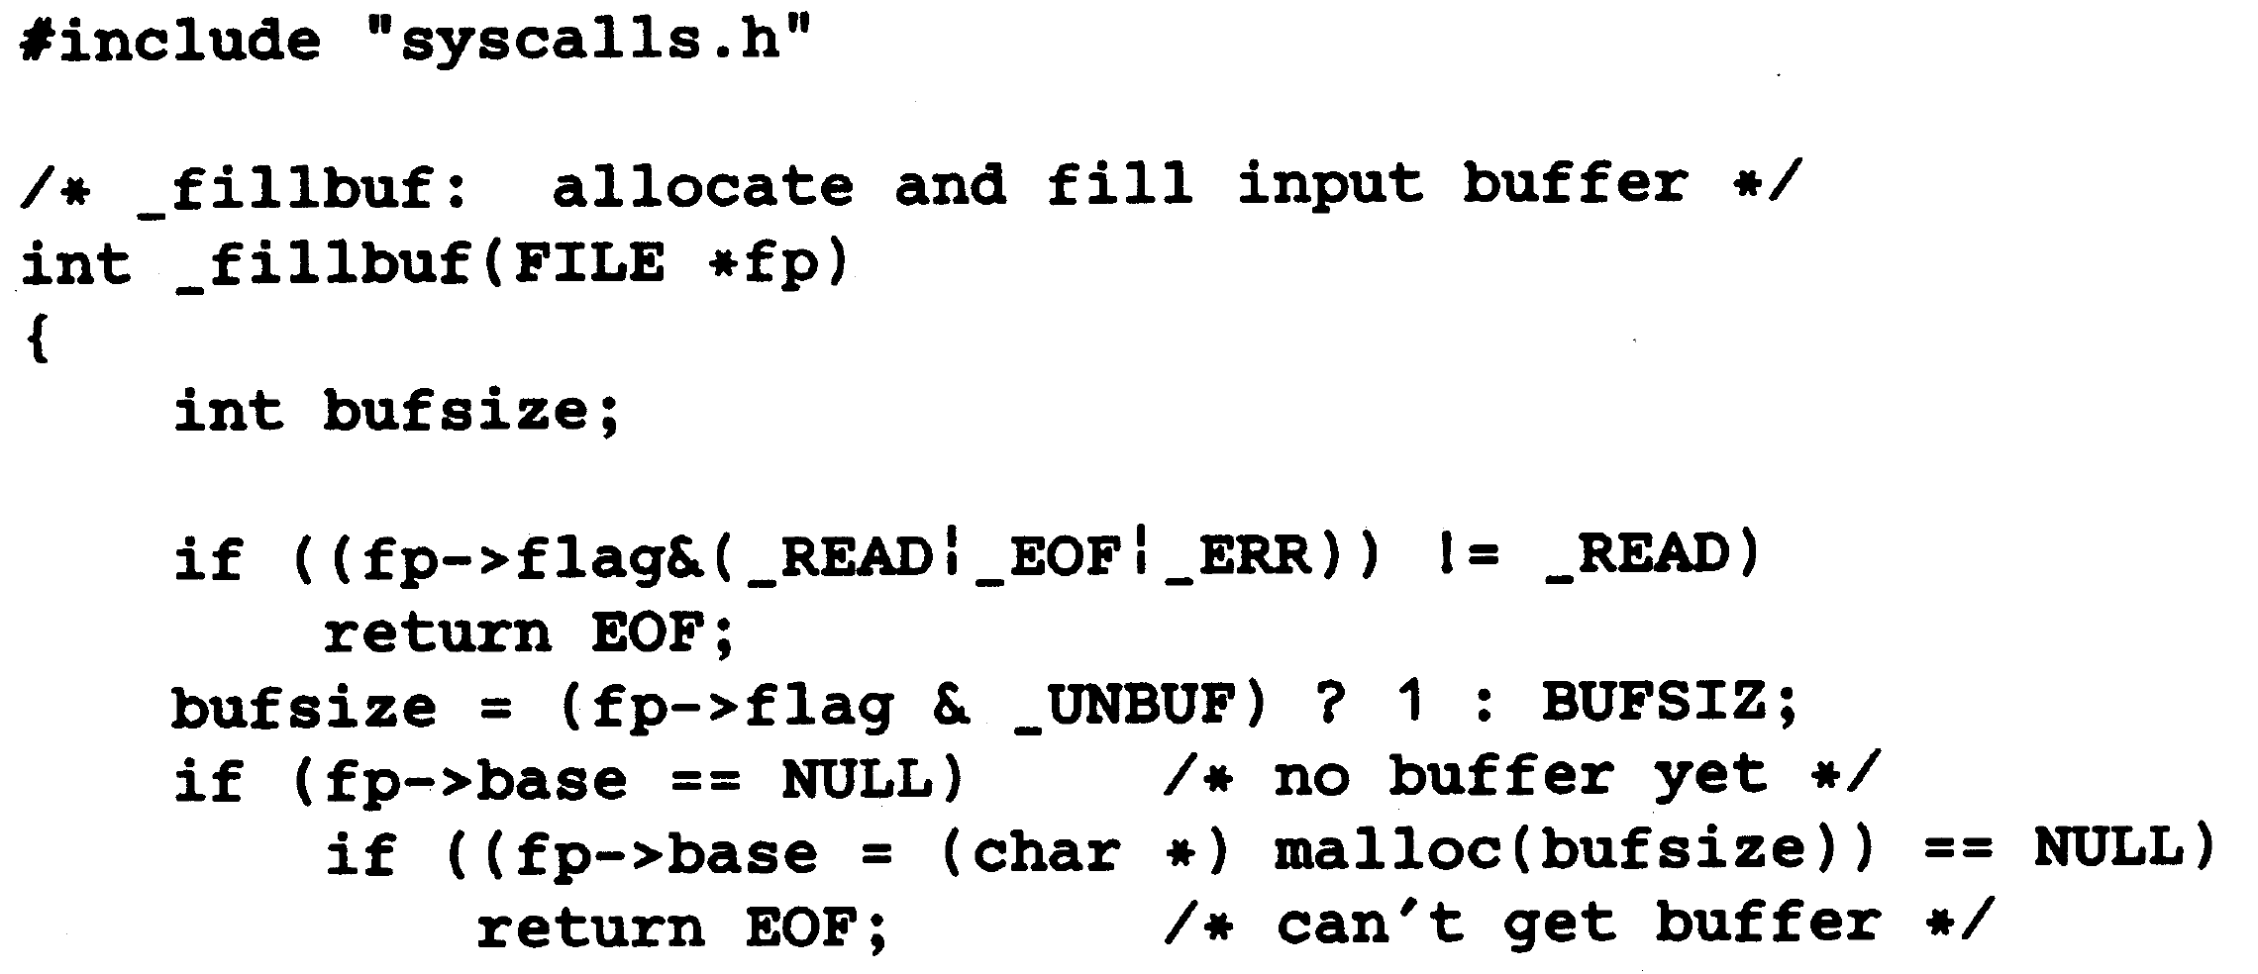
Implementation of Fopen and Getc

Slide 20
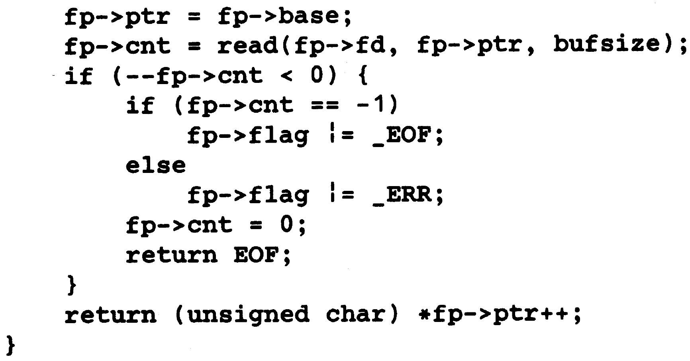
Implementation of Fopen and Getc

Slide 21
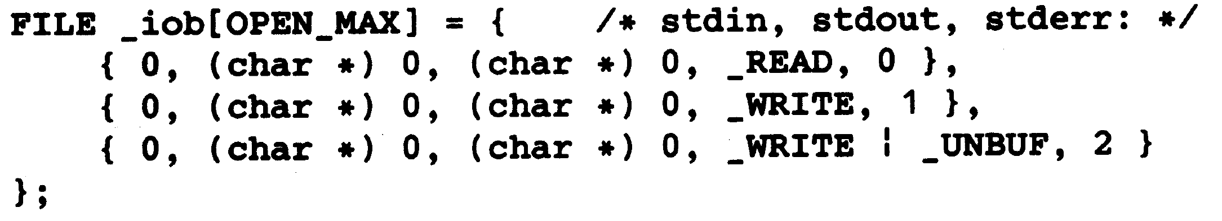
Implementation of Fopen and Getc

Slide 22
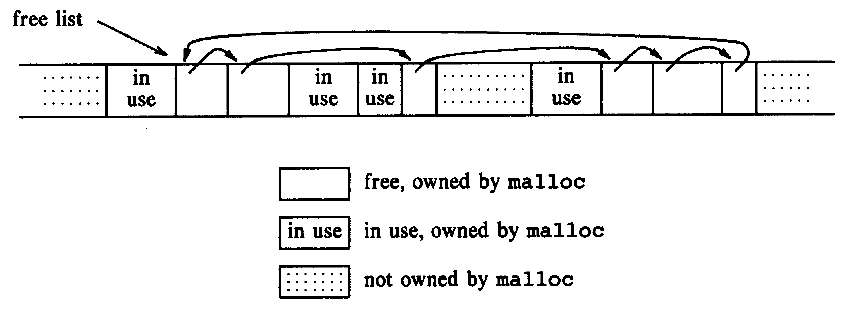
Storage Allocator

Slide 23
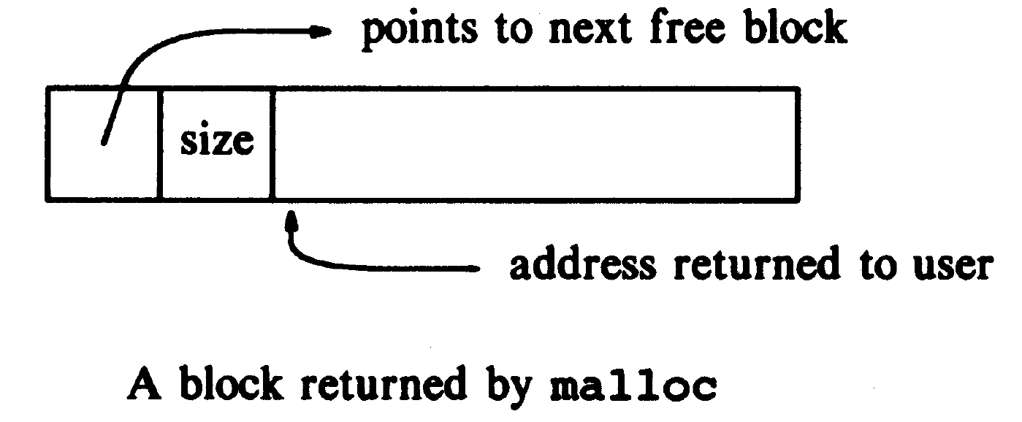
Storage Allocator

Slide 24
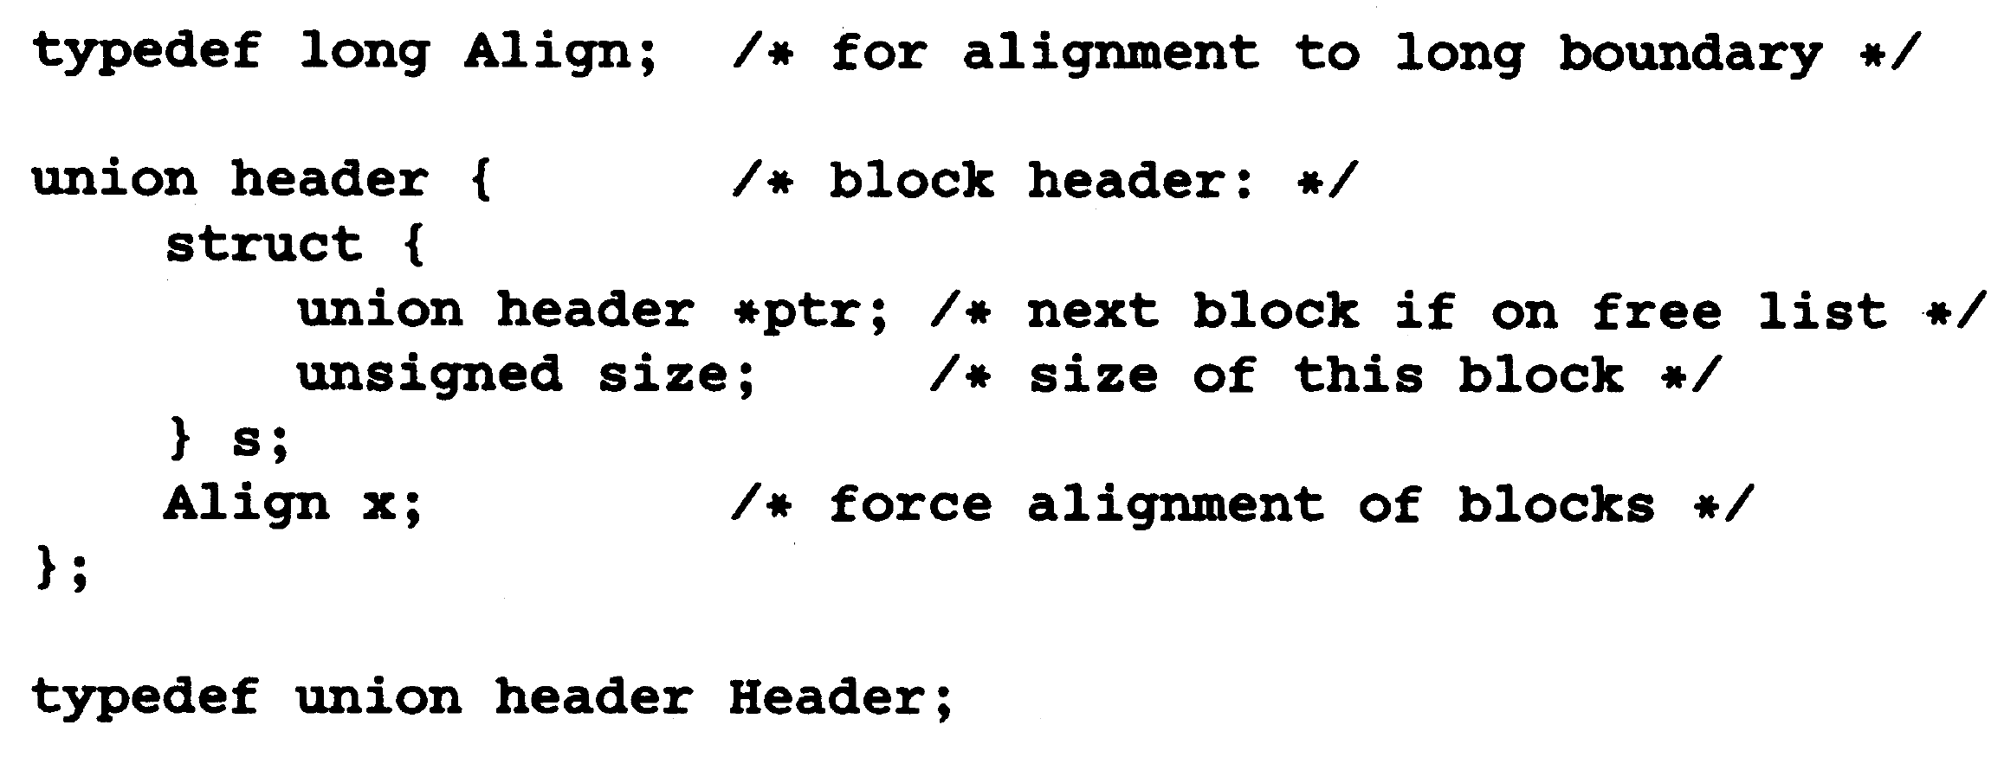
Block Header

Slide 25
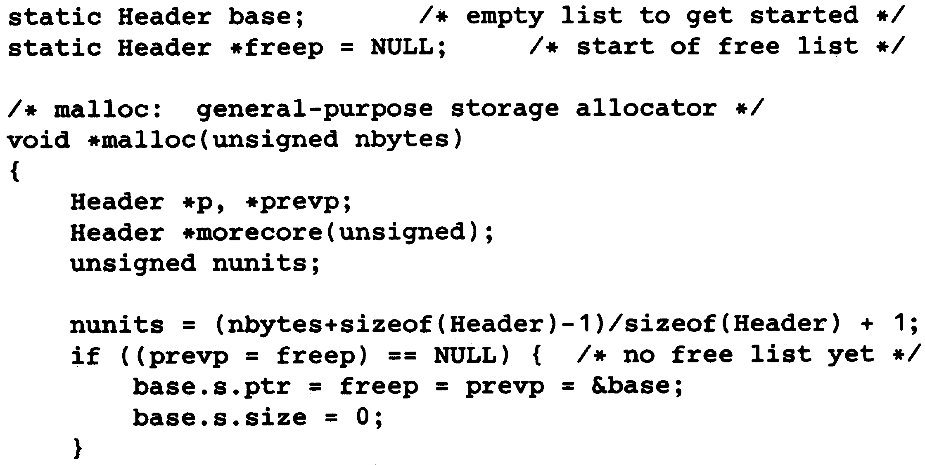
Malloc Implementation

Slide 26
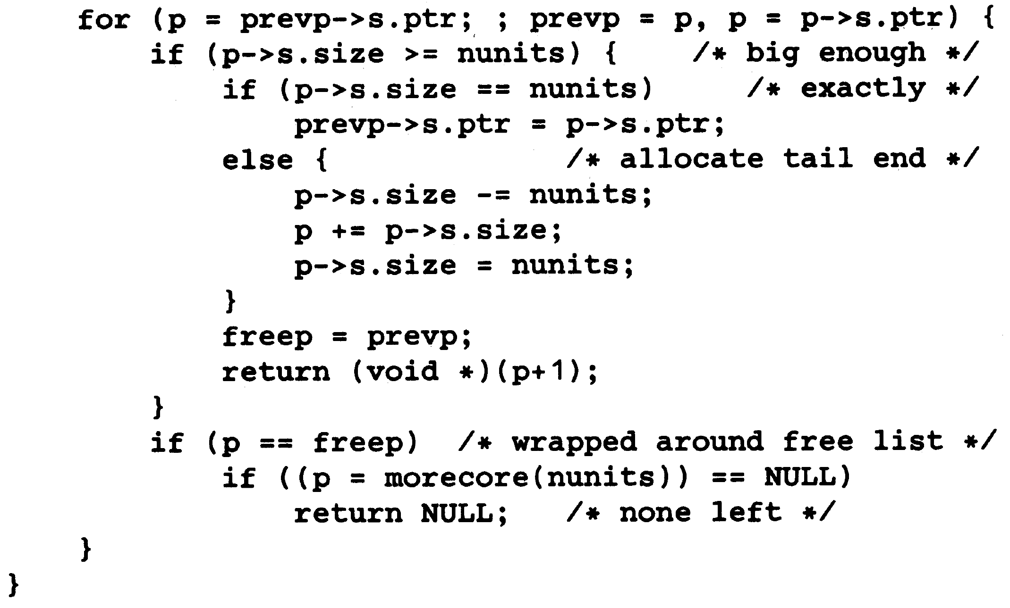
Malloc Implementation

Slide 27
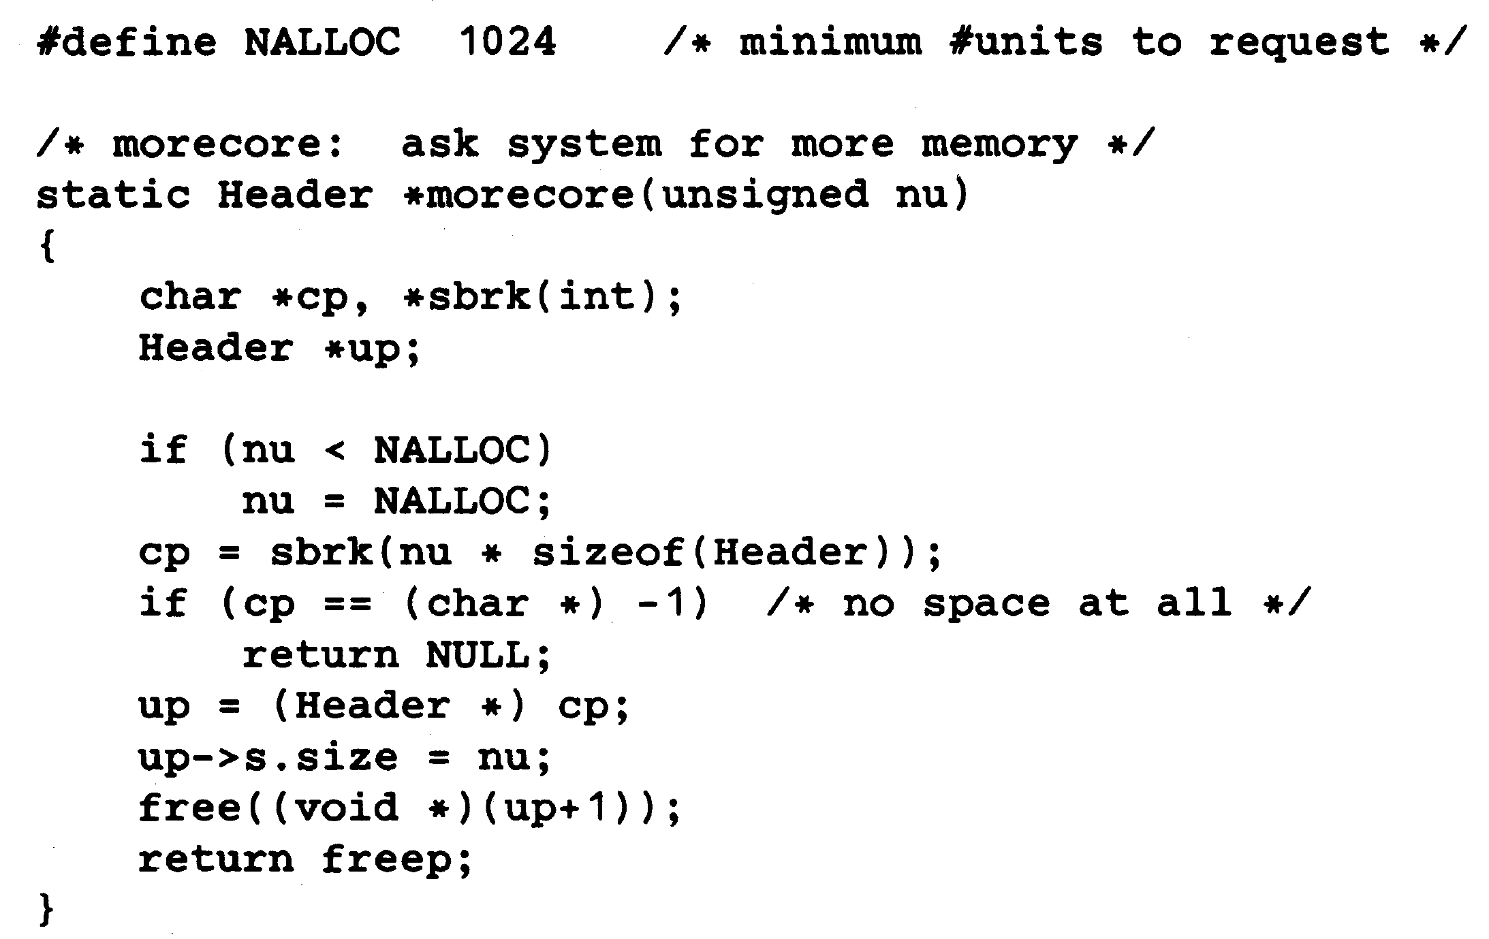
Malloc Implementation

Slide 28
Malloc Implementation

Slide 29
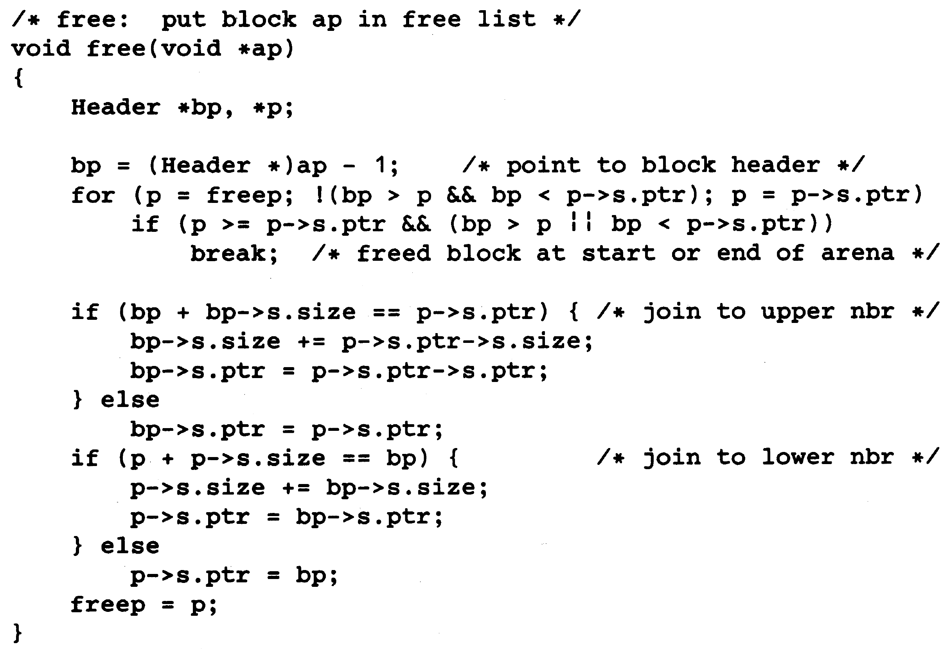
Free Implementation

Slide 30
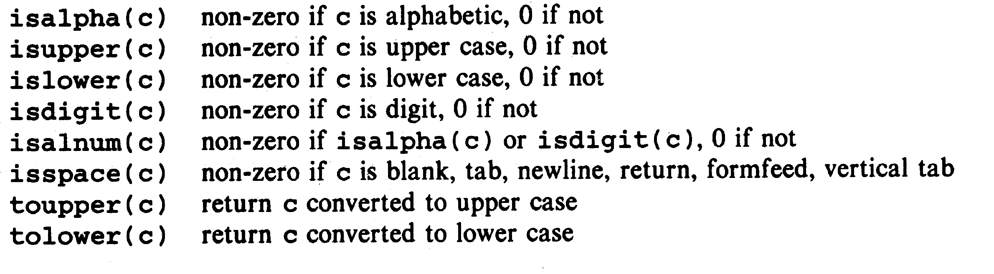
Helpful Functions: Character Testing/Conversion

Slide 31
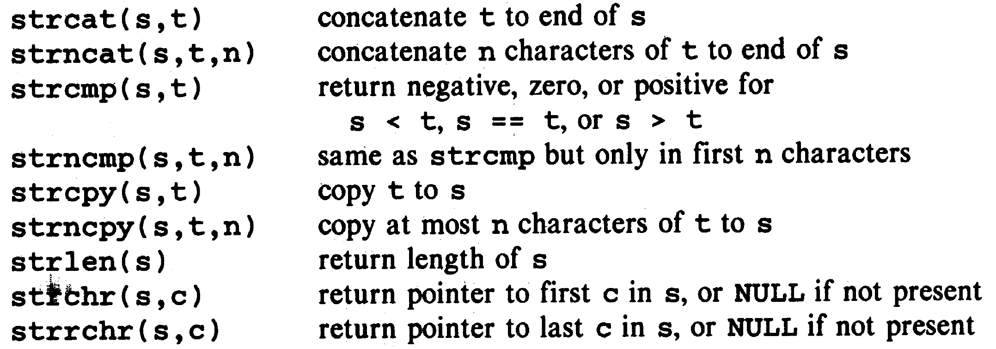
Helpful Functions: String Operations (string.h)

Slide 32
Helpful Functions: String Operations (string.h)

Slide 33
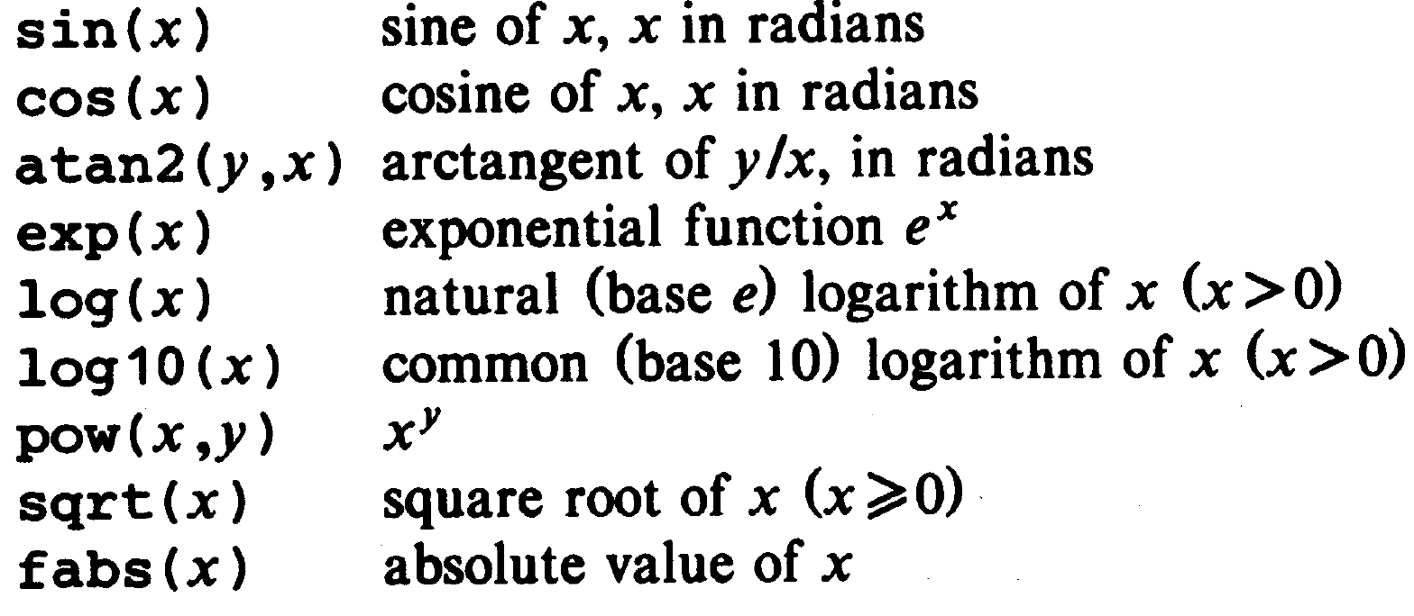
Helpful Functions: Mathematical Operations (math.h)

Slide 34
Helpful Functions: Random Number Generation
rand(): returns a random integer in the range 0, 1, 2, …, RAND_MAX
To generate a uniformly distributed random number in the range [0,1),
#define frand() ((double) rand() / (RAND_MAX + 1))

